Slide 1
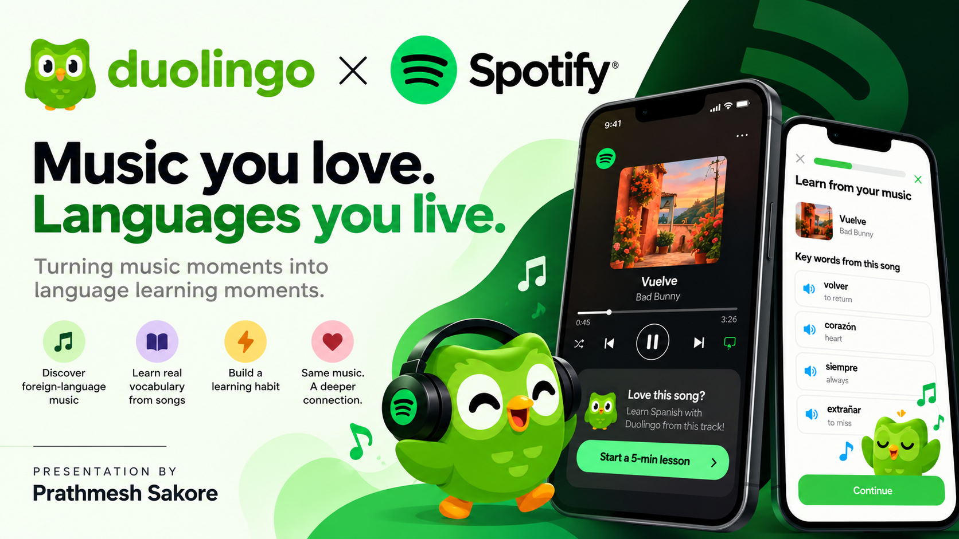

Slide 2
Strategic Alignment: Why Spotify & Why Now?
Expanding Duolingo from isolated study time to an always-on daily lifestyle habit.
The Problem We're Solving | Why This Partnership Wins
People listen without understanding | Tapping into a massive daily audience
Millions stream songs in Spanish, Korean, or French every day, but have no idea what the lyrics mean. That’s a huge group of interested learners sitting right in front of us. | Spotify has over 600 million daily listeners who are already playing this music. We don't have to find new users—they are already there.
Isolated study time causes churn | Building on existing habits (Habit-Stacking)
Opening a separate app just to "study" feels like homework. When life gets busy, study habits are the first thing people drop | Instead of asking people to make time for Duolingo, we attach 2-minute lessons to things they already do daily—like commuting, walking, or working out.
"This builds on a pattern Duolingo already runs — from Brawl Stars to World Cup marketing."

Slide 3
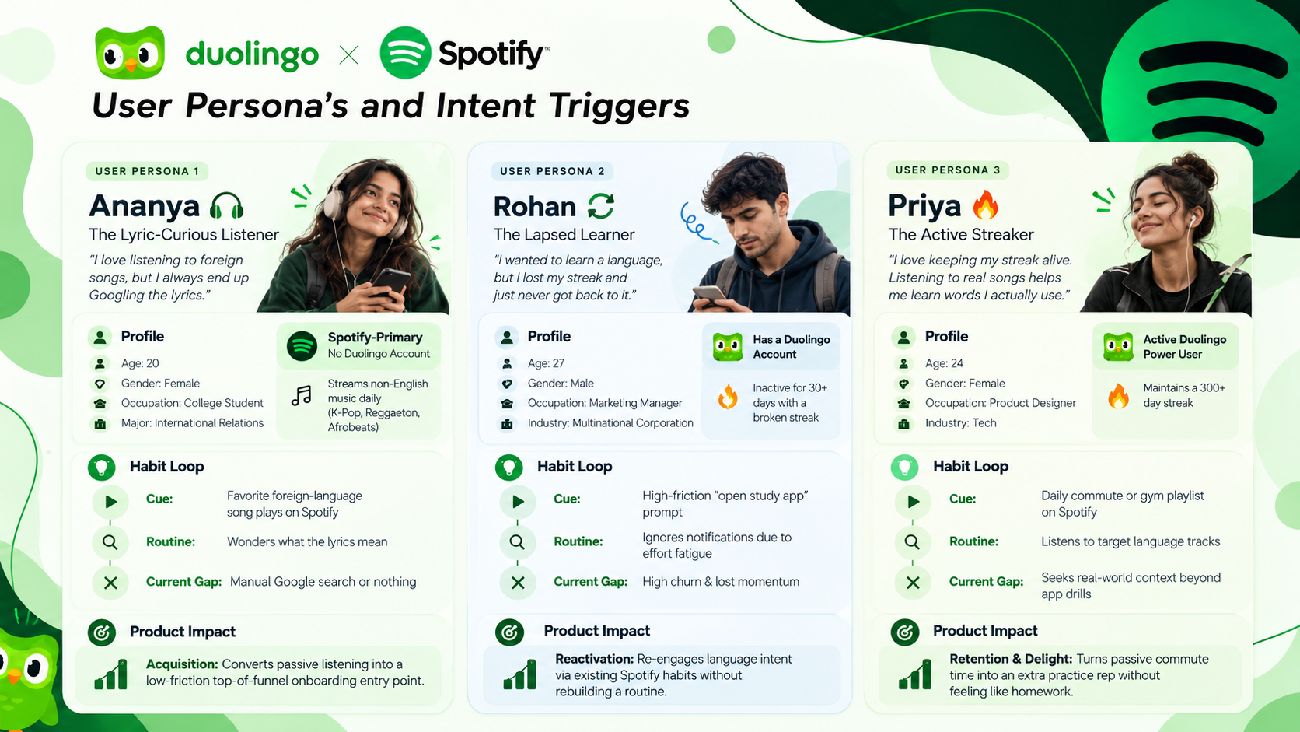
User Persona’s and Intent Triggers

Slide 4
End-to-End User Journey
How seamless cross-app integration turns a Spotify listening session into a Duolingo lesson
Targeted Trigger: A small "Learn this song" chip appears on the lyrics view for supported non-English tracks.
User Eligibility: Shown to users with active or expired Duolingo accounts, or those who opt in via a one-time prompt.
Action: Tapping the chip initiates the cross-app learning handoff
Data Transfer: Firing the chip sends song ID, artist, and detected language payload into the Duolingo app.
Edge-Case Handling: Directs to the installed Duolingo app or a lightweight web view for users without the app.
Frictionless Entry: Opens immediately without manual setup or searching
Custom Content: Opens directly to a 2–3 minute interactive lesson built from that song's lyrics.
Key Exercises: Features vocabulary flashcards from key phrases and lyric fill-in-the-blank drills.
Comprehension Check: Ends with a quick check to reinforce newly learned song vocabulary.
Duolingo Side: Awards XP and preserves/extends streak credit upon lesson completion.
Spotify Side: Unlocks a "Song Unlocked" badge displayed back on that track's Spotify lyrics page.
Growth Loop: Closes the loop by driving repeat listens with full lyric understanding.
Step 1
Spotify CTA
Step 2
Deeplink Handoff
Step 3 Duolingo
Step 4
Reward Loop

Slide 5
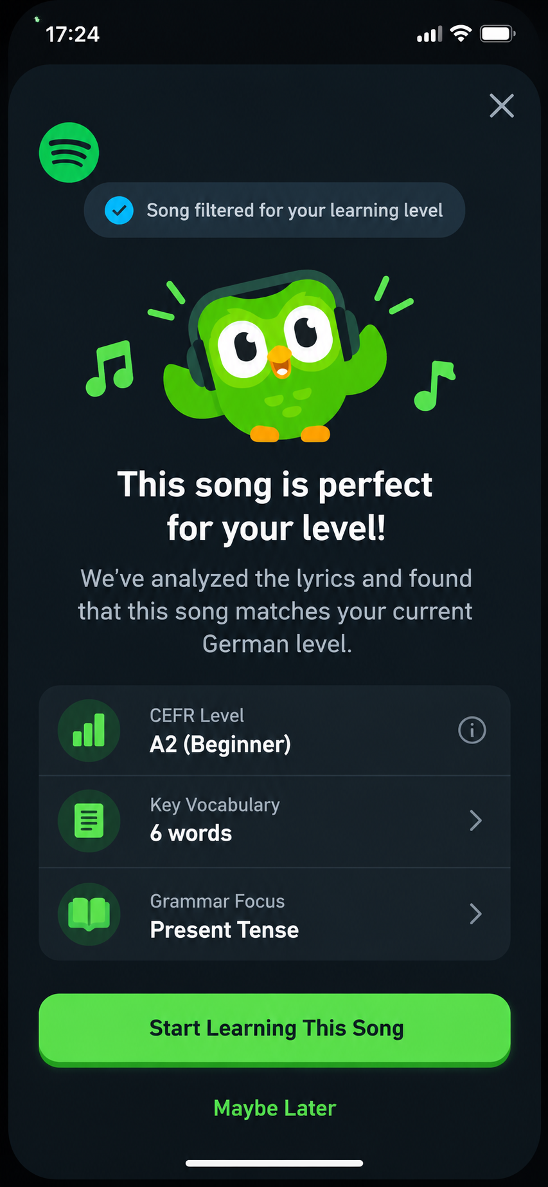
Core Feature Specifications (MVP Scope).
CEFR Lyric Parsing & Song Selection
Mechanism and Rules:
Automated Classification: Maps Spotify lyrics to standard CEFR levels (A1–C2) based on vocabulary frequency and syntax complexity.
Smart Filtering: Hides prompts for tracks exceeding the learner's current level to prevent frustration.
Safety & Quality Pipeline: Filters out explicit tracks and heavy slang in v1 to protect brand reputation.
Template Pre-Processing: Pre-builds 2-minute lesson templates (5–8 key terms + 1 grammar pattern).
Success Metrics :
Classification Precision: greater than equal to 95 % alignment with CEFR standards. Safety Filter Precision: Zero explicit content leaks in auto-generated lessons. Modal Conversion Rate: % of users who click "Start Learning This Song".

Slide 6
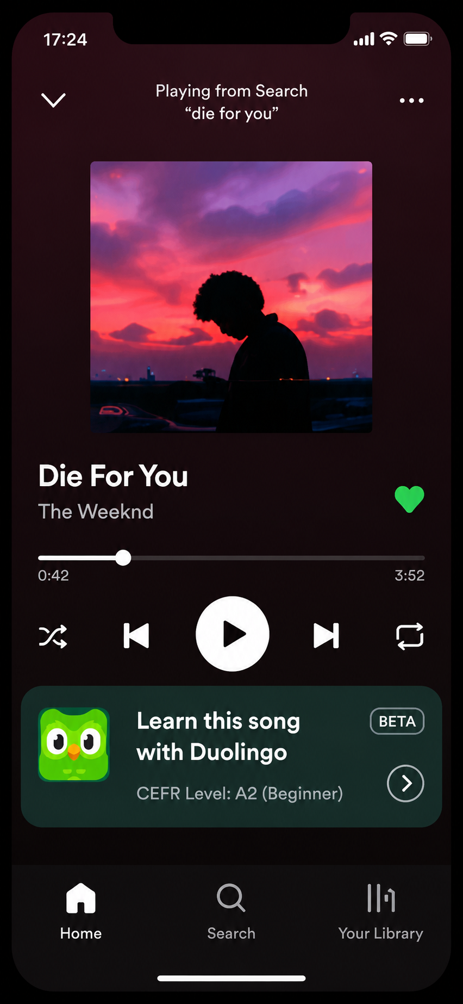
Feature 2 – Contextual In-App Discovery (Spotify Widget)
(Mechanics & Rules):
Dynamic Widget Injection: Embeds a native "Learn this song with Duolingo" prompt directly inside the Spotify player view for foreign-language tracks.
Targeted Triggering: Displays dynamically based on detected song language and user Duolingo profile status.
One-Tap Entry: Tapping the widget initiates the deep-linking sequence straight into the lesson.
(Success Metrics):
Widget CTR (Click-Through Rate): % of song listeners who tap the Duolingo chip.
Top-of-Funnel Acquisition: New Duolingo sign-ups initiated directly from Spotify.

Slide 7
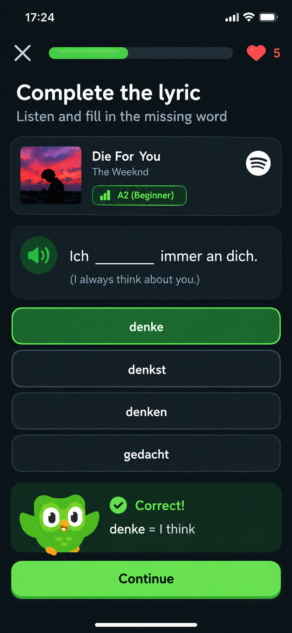
Feature 3 – Interactive Lyric Micro-Lessons (Duolingo App)
(Mechanics & Rules):
Audio-Anchored Drills: Plays a 5-second audio snippet of the actual track alongside fill-in-the-blank vocabulary challenges.
Real-Time Pedagogical Feedback: Provides immediate translation breakdowns and grammar explanations (e.g., "denke = I think").
Bite-Sized Pacing: Designed to take under 120 seconds, awarding XP and preserving daily streaks.
(Success Metrics):
Lesson Completion Rate: % of started song lessons finished successfully.
D1 Retention Uplift: Lift in next-day app open rate for users completing song drills.

Slide 8
Feature Prioritization Framework
Strategic Takeaway: The Spotify In-App Widget yields the highest RICE score (135), making it the primary P0 launch driver due to maximum top-of-funnel reach and minimal effort.
Priority | Feature | Reach (1-10) | Impact (1-3) | Confidence (%) | Effort (1-5) | RICE Score | MVP Status
1 | Spotify In-App Discovery Widget | 10 | 3 | 90% | 2 | 135 | P0(Must-Have)
2 | CEFR Lyric Parsing & Safety Engine | 9 | 3 | 80% | 3 | 72 | P0(Must-Have
3 | Interactive Lyric Micro-Lessons | 7 | 2 | 70% | 3 | 33 | P1(Should Have)

Slide 9
GTM Strategy
Phase | Timeline | Scope | Key Channels / Activities | Success Metric
1. Internal Dogfood | Weeks 1–2 | Duolingo + Spotify employees only | Validate deep link reliability, lesson quality, cross-app badge sync | Zero critical bugs before external launch
2. Pilot Market Launch | Weeks 3–8 | Single market, single language (e.g. South Korea, Korean) | Spotify lyrics-page CTA (no paid promotion) + organic social teaser | CTA → Lesson Completion Rate > 25%
3. Language Expansion | Weeks 9–14 | Top 5 Duolingo languages by learner volume | Same CTA mechanic scaled + Duolingo owned-channel push (email, in-app) | New Account Creation Rate > 8%
4. Global Launch + Co-Marketing | Week 15+ | All markets | Joint PR moment (Duolingo/Spotify social, press), timed to a major non-English album release | Lapsed-User Reactivation Rate > 15%

Slide 10


Presentation By
Prathmesh Sakore

